Slide 1

Team – Project AIRA Solution Type: Prototype
Names of Team Members
Krishna Vamsi
Phillipa Burgess
Aryan Jaiswal
Charishma Regulavalasa
Notes:
Korrie

Slide 2
AIRA: Your Personal PhD Research Team
Talk Track: From Blank Page to Published Paper, Instantly.
"Hey everyone. We're here to talk about one of the most frustrating problems we face as students. You have a dozen great ideas, but getting the chance to actually work on them feels impossible. Research assistantships are incredibly competitive, and it feels like you need experience to get experience. "This Student Ambassador AI Projects cohort this is the problem we are obsessed with solving, We call it AIRA.”

Slide 3
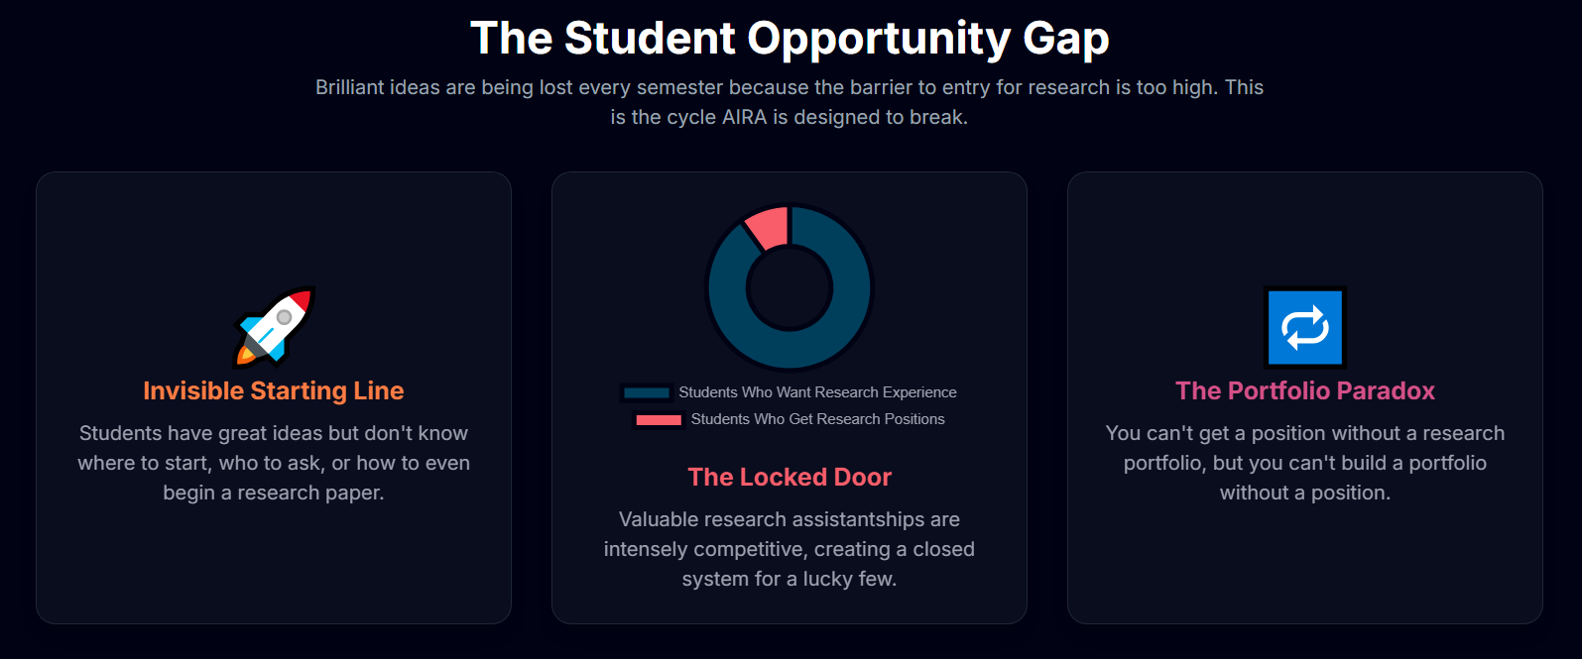
The Opportunity : The Innovation Wall
Notes:
Korrie
updated 7/21

Slide 4
Solution: AIRA: A PhD-Level Virtual Lab.
AIRA collapses the journey from months to minutes.
It provides an integrated, end-to-end workflow that guides you from initial spark to final publication. With AIRA, you can instantly:
EXPLORE | DESIGN & SIMULATE | VALIDATE | PUBLISH
Your idea with a team of AI specialists. | Your hypothesis in a virtual lab environment. | Your findings against real-world data. | A complete, professionally formatted research paper.
Talk Track:
"AIRA is your automated research co-pilot. It's not just one tool; it's the entire workflow, unified in a single platform. We've distilled the complex research journey into four simple steps. You Explore your idea with a team of AI experts. You Design and Simulate your hypotheses. You Validate the results against your own data. And you Draft a finished, cited report with a single click. We're turning a marathon into a sprint."
Notes:
Korrie
updated 7/21

Slide 5
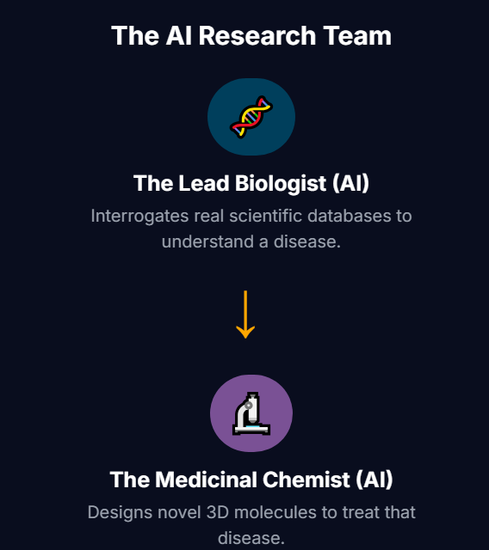
Phase 1: AIRA for Life Sciences
First, we had to build the core: a research team of AI agents that operates at a PhD level.
Our MVP Phase 1 is a multi-agent system for Life Sciences where specialized AIs collaborate as a virtual drug discovery lab:
The Lead Biologist (AI): Interrogates real scientific databases to understand a disease.
The Medicinal Chemist (AI): Designs novel 3D molecules to treat that disease.
The Principal Investigator (AI): Manages the entire workflow, interrogates the results, and draws a scientific conclusion.
Notes:
Korrie
updated 7/21

Slide 6
Demo
Important: limit demo length to 1-minute
Pre-recorded demo of solution (Video or animated gif).
Recommend no audio, but talk over the video.
Embed if <10MB, or post link here for us to download.
On occasion, a sequence of screenshots might be preferred.
Notes:
Korrie
updated 7/21

Slide 7
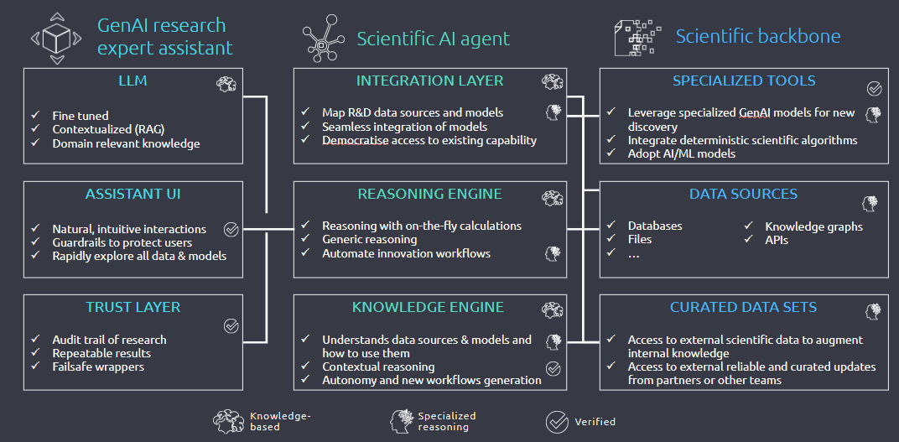
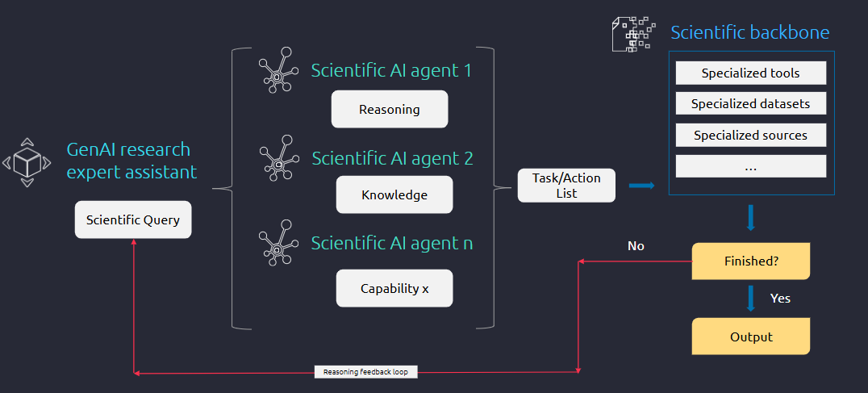
How It Works: Our Composable Architecture

Slide 8
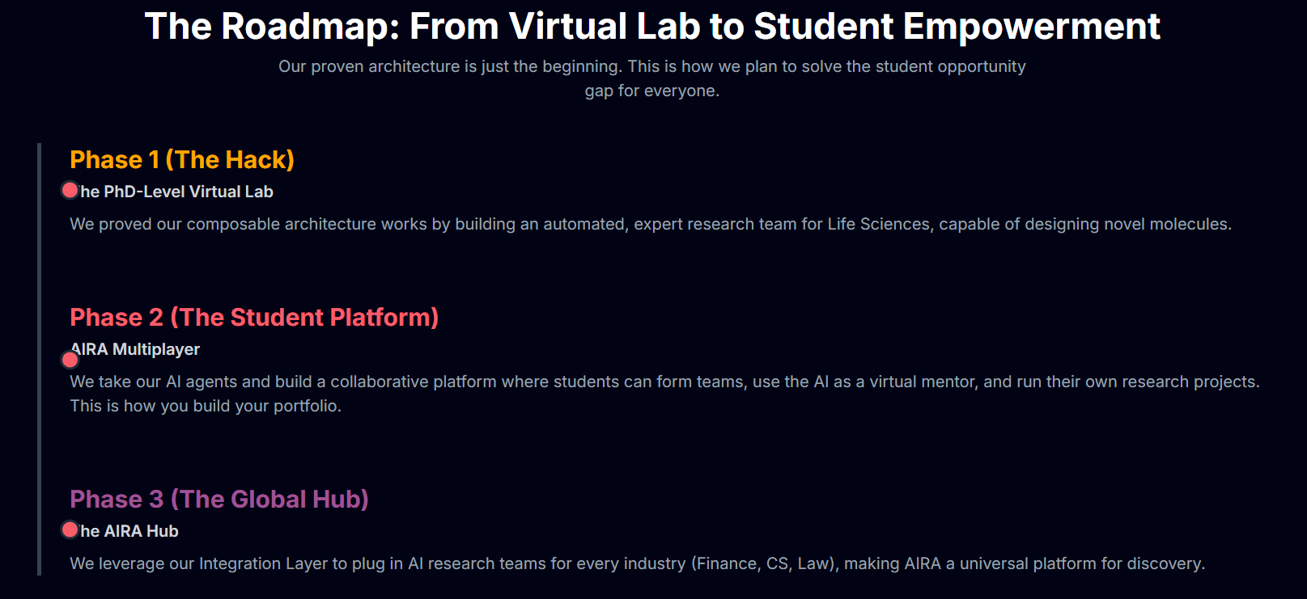
Future Updates

Slide 9
The Roadmap: The Path to an Autonomous Discovery Engine
MVP Phase 2: The Collaborative Hub | MVP Phase 3: The Universal Platform
Unleash Team Velocity. | Democratize Research for Every Industry.
• Real-Time Team Workspaces & Chat to share insights instantly. | • Swappable AI Agent Libraries for Finance, Market Research, Technology, and Legal.
• Shared Project Repositories on a secure Azure cloud backend. | • Pluggable Architecture to integrate proprietary data and custom AI models.
Notes:
Korrie
updated 7/21

Slide 10
AIRA: Your Research Opportunity, On-Demand.
Thankyou
-Team Project AIRA

